Slide 1









My Linear Equations Interactive Notebook
$$×$$
$$\frac{1}{2}$$
$$÷$$
$$+$$
$$−$$
$$\frac{3}{5}$$
$$7$$
Name
Class
Teacher
Term 1 Semester 1
$$5^{2}$$
$$\sqrt{9}$$
1

Slide 2
Contents
Glossary or Formula Page
Page
Date
Description
2
3

Slide 3
Tasks
24
7
30
Essential Question
Questions
Notes
Summary
6
7

Slide 4
24
7
30
Date
Simultaneous Equations
EQ – How do I find the point of intersection graphically?
7

Slide 5
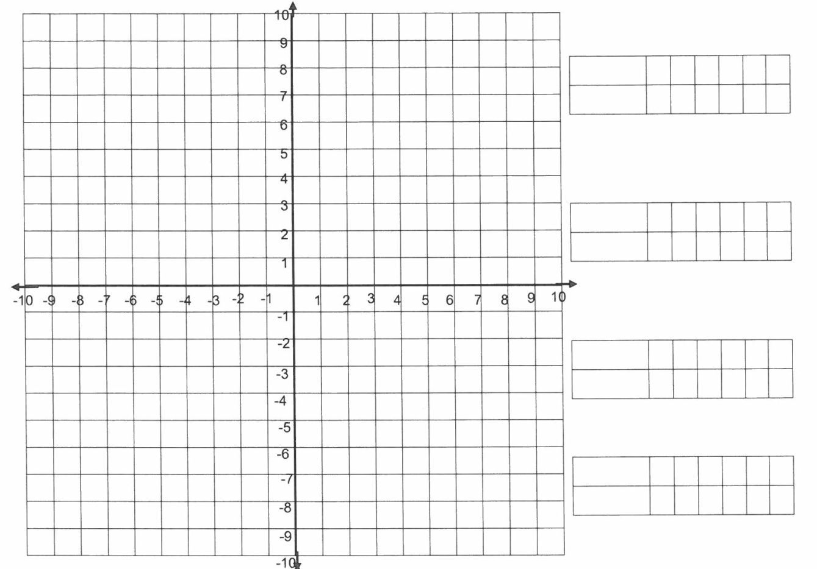
24
7
30
Date
Simultaneous Equations
EQ – How do I find the point of intersection graphically?
Use a graphical method to find the intersection of these two equations y = 2x – 4 and y = -3x + 1
Where do the two equations meet / intersect?
x -1 0 1 2 3
Y=2x-4 -6 -4 -2 0 2
x -1 0 1 2 3
Y=-3x+1 4 1 -2 -5 -8
The solution is x = 1 and y = -2 which is the point (1,-2)
Don’t forget – complete the table of values and then graph each line to find the point of intersection!
7

Slide 6
Exercises
Exercise 2.5 from Dwyer
Friday we are booked into the computer room 07-202. If you have them bring your laptops or ipads ☺
All to be done with a smile on your faces.

Slide 7
Notes Review
24, 7 ,30
Date
Title
Essential question
Notes complete
Notes complete with colour and diagrams
Questions completed
Contents page filed in
Formula page filled in

Slide 8
Homework
Review your notes and write a summary answering the essential question.

